Slide 1
Pivoting Data in SQLPathFinder
(view in slide show mode)

Slide 2
SQLPathFinder supports Pivot queries. This is also known as Data Splitting in applications like JMP. Pivot queries allow you to transform rows of data into columns of data.

Slide 3
Pivot Queries
E.g., assume this was our E-Test intermediate output…
Lot Program Wafer Test_Name Value
2668 12640EE93 718 ACLEN_035 .00966
2668 12640EE93 718 ACEN_04 .00162
2668 12640EE93 718 ACLEN_04_HP .00135
2669 12640EE93 792 ACLEN_035 .00935
Notes:
4/3/97
28
Components Training
SQLPathFinder also supports Pivot queries. This is also known as Data Splitting in applications like JMP. Pivot queries allow you to invert your output and transform rows of data into columns of data.

Slide 4
Pivot Queries
and below is what we want to generate...
Lot Program Wafer Test_Name Value
2668 12640EE93 718 ACLEN_035 .00966
2668 12640EE93 718 ACEN_04 .00162
2668 12640EE93 718 ACLEN_04_HP .00135
2669 12640EE93 792 ACLEN_035 .00935
Lot Program Wafer ACLEN_035 ACLEN_04 ACLEN_04_HP
2668 12640EE93 718 .00966 .00162 .00135
2669 12640EE93 792 .00935 . .
Notes:
4/3/97
29
Components Training
Here we have sample Pivot report. Note that the Test Name values and the Test Name headers have been transformed from rows into columns. The transformation has been done around columns Lot, Program & Wafer. These are the pivot columns & each row of output will represent a unique combination of the pivot columns. Sometimes you need to eliminate some pivot columns to get the output the way you want.

Slide 5
Pivot Queries
and below is what we want to generate...
SQLPathFinder lets you assign
Pivot attributes to query columns
to transform data rows
to columns
Lot Program Wafer Test_Name Value
2668 12640EE93 718 ACLEN_035 .00966
2668 12640EE93 718 ACEN_04 .00162
2668 12640EE93 718 ACLEN_04_HP .00135
2669 12640EE93 792 ACLEN_035 .00935
Lot Program Wafer ACLEN_035 ACLEN_04 ACLEN_04_HP
2668 12640EE93 718 .00966 .00162 .00135
2669 12640EE93 792 .00935 . .
Notes:
4/3/97
29
Components Training
Here we have sample Pivot report. Note that the Test Name values and the Test Name headers have been transformed from rows into columns. The transformation has been done around columns Lot, Program & Wafer. These are the pivot columns & each row of output will represent a unique combination of the pivot columns. Sometimes you need to eliminate some pivot columns to get the output the way you want.

Slide 6
Pivot Vocabulary
Columns to be transposed are set as the Pivot Value
Value
Lot Program Wafer Test_Name Value
2668 12640EE93 718 ACLEN_035 .00966
2668 12640EE93 718 ACEN_04 .00162
2668 12640EE93 718 ACLEN_04_HP .00135
2669 12640EE93 792 ACLEN_035 .00935
Pivot
Lot Program Wafer ACLEN_035 ACLEN_04 ACLEN_04_HP
2668 12640EE93 718 .00966 .00162 .00135
2669 12640EE93 792 .00935 . .
Notes:
4/3/97
33
Components Training

Slide 7
Pivot Vocabulary
The column that holds the headers for the Pivot is called the Pivot Header
Header
Lot Program Wafer Test_Name Value
2668 12640EE93 718 ACLEN_035 .00966
2668 12640EE93 718 ACEN_04 .00162
2668 12640EE93 718 ACLEN_04_HP .00135
2669 12640EE93 792 ACLEN_035 .00935
Pivot
Lot Program Wafer ACLEN_035 ACLEN_04 ACLEN_04_HP
2668 12640EE93 718 .00966 .00162 .00135
2669 12640EE93 792 .00935 . .
Notes:
4/3/97
33
Components Training

Slide 8
Pivot Vocabulary
The remaining columns serve as the Pivot Rows around which the transpose is done.
Row
Row
Row
Lot Program Wafer Test_Name Value
2668 12640EE93 718 ACLEN_035 .00966
2668 12640EE93 718 ACEN_04 .00162
2668 12640EE93 718 ACLEN_04_HP .00135
2669 12640EE93 792 ACLEN_035 .00935
Pivot
Lot Program Wafer ACLEN_035 ACLEN_04 ACLEN_04_HP
2668 12640EE93 718 .00966 .00162 .00135
2669 12640EE93 792 .00935 . .
Notes:
4/3/97
33
Components Training

Slide 9
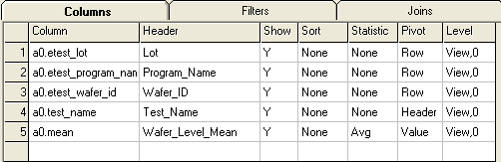
Pivot Queries
Set the appropriate pivot value in the Pivot column of the Columns Grid
Lot Program Wafer ACLEN_035 ACLEN_04 ACLEN_04_HP
2668 12640EE93 718 .00966 .00162 .00135
2669 12640EE93 792 .00935 . .
Notes:
4/3/97
34
Components Training
This slide shows how we set up the SQLPathFinder Query Grid to accomplish the Pivot report. Pivot attributes are assigned to each column in the grid.
Note that the VALUE column (or the column to be transposed) also has a STATISTICAL summary associated with it. This is to ensure that there will be a maximum of one transposed column value and header for each pivot grouping. Any number of columns can have a VALUE attribute and be transposed
END

Slide 10
Pivot Queries
Column a0.Mean is the Pivot Value. A summary statistic must also be applied to every Pivot Value column
Lot Program Wafer ACLEN_035 ACLEN_04 ACLEN_04_HP
2668 12640EE93 718 .00966 .00162 .00135
2669 12640EE93 792 .00935 . .
Notes:
4/3/97
34
Components Training
This slide shows how we set up the SQLPathFinder Query Grid to accomplish the Pivot report. Pivot attributes are assigned to each column in the grid.
Note that the VALUE column (or the column to be transposed) also has a STATISTICAL summary associated with it. This is to ensure that there will be a maximum of one transposed column value and header for each pivot grouping. Any number of columns can have a VALUE attribute and be transposed
END

Slide 11
Pivot Queries
Column a0.Test_Name is the
Pivot Header
Lot Program Wafer ACLEN_035 ACLEN_04 ACLEN_04_HP
2668 12640EE93 718 .00966 .00162 .00135
2669 12640EE93 792 .00935 . .
Notes:
4/3/97
34
Components Training
This slide shows how we set up the SQLPathFinder Query Grid to accomplish the Pivot report. Pivot attributes are assigned to each column in the grid.
Note that the VALUE column (or the column to be transposed) also has a STATISTICAL summary associated with it. This is to ensure that there will be a maximum of one transposed column value and header for each pivot grouping. Any number of columns can have a VALUE attribute and be transposed
END

Slide 12
Pivot Queries
The remaining columns are the Pivot Rows
Lot Program Wafer ACLEN_035 ACLEN_04 ACLEN_04_HP
2668 12640EE93 718 .00966 .00162 .00135
2669 12640EE93 792 .00935 . .
Notes:
4/3/97
34
Components Training
This slide shows how we set up the SQLPathFinder Query Grid to accomplish the Pivot report. Pivot attributes are assigned to each column in the grid.
Note that the VALUE column (or the column to be transposed) also has a STATISTICAL summary associated with it. This is to ensure that there will be a maximum of one transposed column value and header for each pivot grouping. Any number of columns can have a VALUE attribute and be transposed
END

Slide 13
Pivot Queries
Lot Program Wafer ACLEN_035 ACLEN_04 ACLEN_04_HP
2668 12640EE93 718 .00966 .00162 .00135
2669 12640EE93 792 .00935 . .
Notes:
4/3/97
34
Components Training
This slide shows how we set up the SQLPathFinder Query Grid to accomplish the Pivot report. Pivot attributes are assigned to each column in the grid.
Note that the VALUE column (or the column to be transposed) also has a STATISTICAL summary associated with it. This is to ensure that there will be a maximum of one transposed column value and header for each pivot grouping. Any number of columns can have a VALUE attribute and be transposed
END

Slide 14
Final Quiz!
Following are a few questions on Pivoting.
Notes:
14

Slide 15
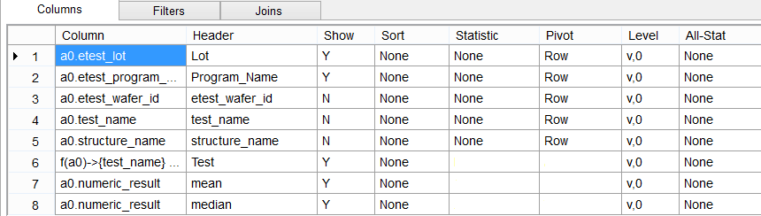
What values should you assign to the Pivot & Statistic cells to get the desired output?
Right-click and choose Pointer Options -> Ballpoint Pen to record responses.
Click Esc to resume slide show
OUTPUT:

Slide 16
What values should you assign to the Pivot & Statistic cells to get the desired output?
OUTPUT:
None
Header
AVG
Value
P50
Value

Slide 17
That concludes the presentation
on Pivoting Data in SQLPathFinder

